Slide 1
Bank Customer Churn Analysis
Hannah Nobles and Wyatt Freeman
11-18-2020

Slide 2
Bank Customer Exit Overview
Customer retention is a primary objective for banks as they compete against a rising number of alternatives such as Venmo and other FinTech applications. There are many variables that factor into a customer’s decision to stay with their bank or leave for alternatives. As Business Analysts, we dug into bank data to find out how well different factors such as Credit Score, Age, and Estimated Salary can predict if a bank customer will leave or not.

Slide 3
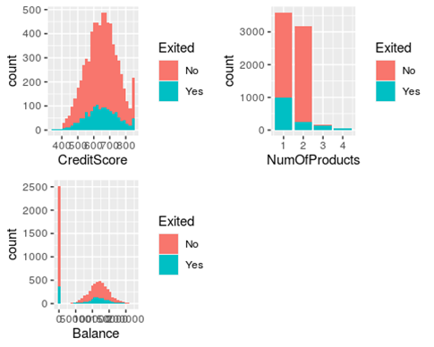
Credit Score, Number of Products Purchased and Account Balance Impact on Customer Exit
The Credit Score graph shows customers are more prone to switching banks when their credit score is around 650. If someone has a score of 650, it is because they have begun taking more interest in their financial health. This is primetime for customers to find financial services that are more suited to their preferences.
The number of bank products graph shows a clear correlation between the number of products used by the customer and churn. Customers exit less when they use more products.
The third graph shows customers with medium-sized accounts are more likely to switch banks. Small and large accounts have less incentive to switch because they are less influenced by competitor advertisements.

Slide 4
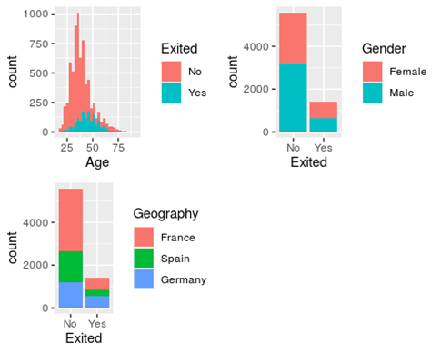
Age, Gender, and Geography Impact on Customer Exit
Bank customers who are around the age of 35-40 are more likely to stay loyal compared to the younger/older customers.
The second graph shows gender is not a large predictor when it comes to bank churn. The ratio of male/female exits is the same for both loyalists and churners.
France has the highest number of loyal customers followed by Spain. German customers are the least loyal.

Slide 5
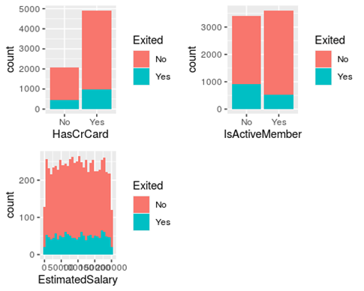
Credit Card, Member Activity, and Salary Impact on Customer Exit
Compared to customers who have a credit card, customers are more willing to exit the bank if they do not have a credit card.
There are more non-active members who have exited than active members. Member activity is not a huge predictor of bank customer exit.
The third graph shows there is no correlation between customer salaries and bank churn.

Slide 6
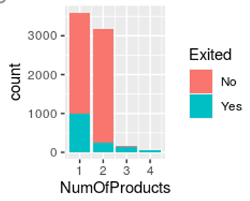
Strongest Predictor of Exit
Customer loyalty increases as they engage with more bank products such as mobile banking applications and FICO credit score tracking. The graph shows a clear decrease in customer exit as customers use more of these products. When customers only use 1 product, such as their checking account, around 33% end up leaving for a competitor. This percentage drops dramatically to around 8% when customers use a second product, such as their bank’s mobile application. Zero customers exit once they use 4 of the bank’s products.

Slide 7
Analyst Recommendation
To reduce customer exit, we recommend an extensive email marketing campaign to convince customers to utilize more bank products. For example, if customers only use their checking account, the bank’s mobile application should be promoted to them so they can more conveniently check their balance. Analysis showed that the number of bank products used by the customer is the strongest predictor of churn. Using more products offered by the bank causes the customer to become more reliant on the bank, causing them to remain loyal. Email campaigns promoting in-house services to existing customers should be a regular business practice going forward.

